Slide 1
Password Generator
Maribeth Estimos
Xian (Richard) Zhang
Zhengwen (Steven) Lei

Slide 2
Agenda
1. What is a Password Generator
2. Why we chose this project
3. Technologies
4. Methodology
5. Team work
6. Reflections
7. References
8. Demo
9. Q & A

Slide 3
What is A Password Generator
Create a random password for use when registering or changing passwords in websites and apps
Platforms:
Computers/Laptops (Mac & Windows), phones (IOS & Android), tablets (ipads & other brands)

Slide 4
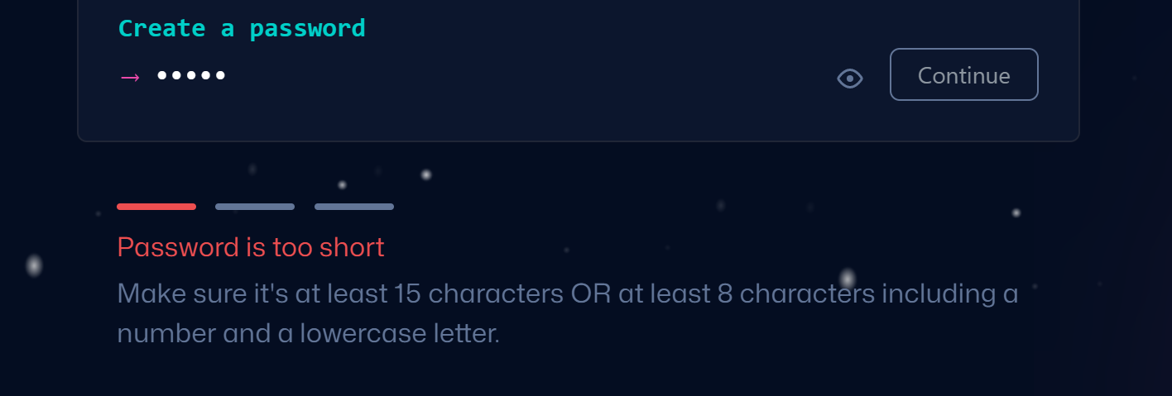
Why we chose this project
Hard to create a complex password

Slide 5
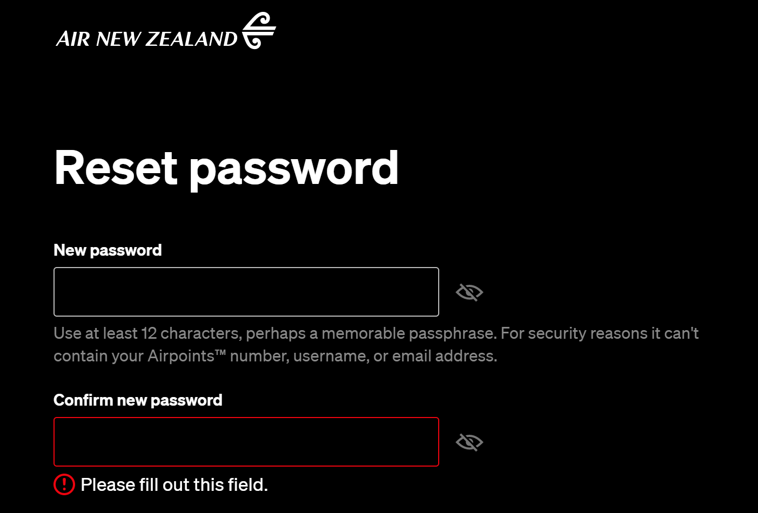
Why we chose this project
Hard to create a complex password

Slide 6
Why we chose this project
Users often create simple passwords like these
123456,1234567890
qwert, qwertyuiop
123456qwerty, 1qaz2wsx

Slide 7
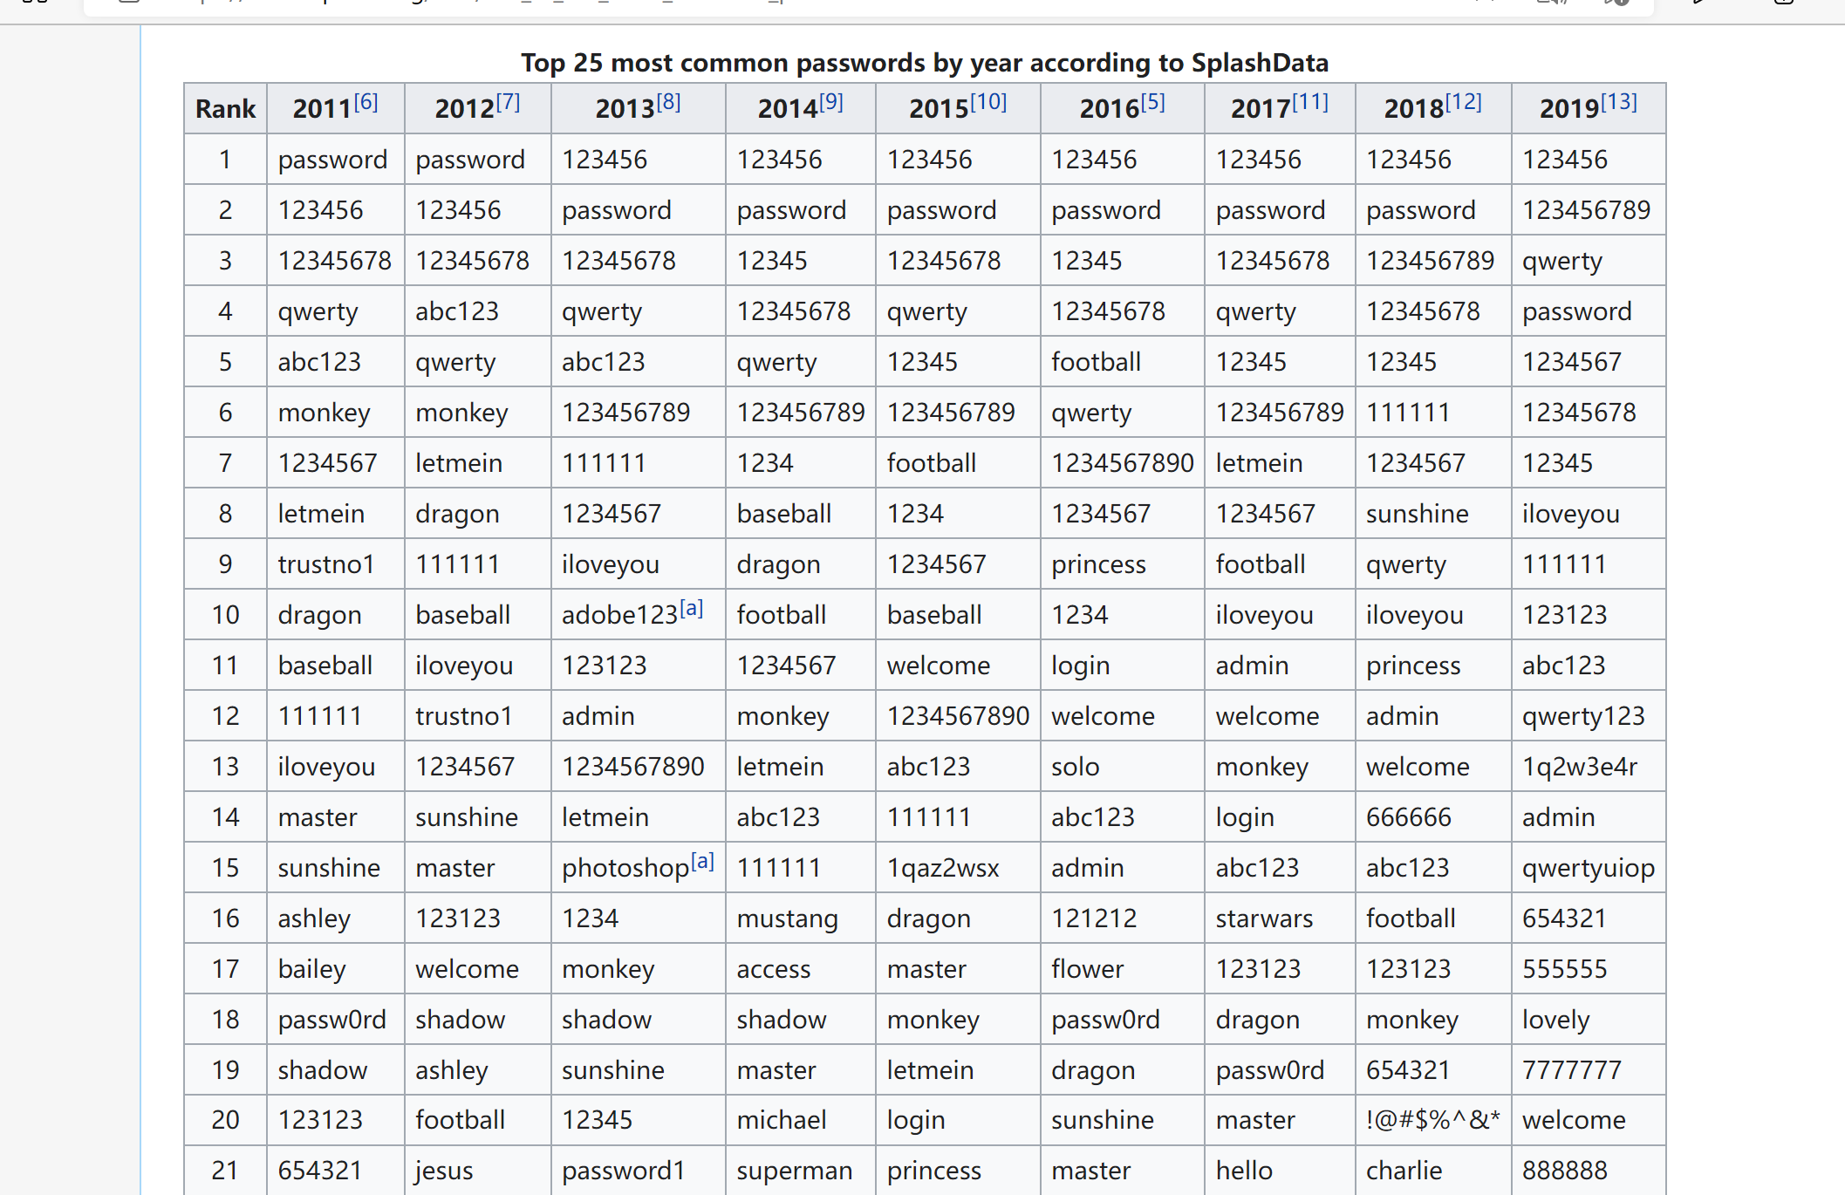
Retrived from: List of the most common passwords - Wikipedia

Slide 8
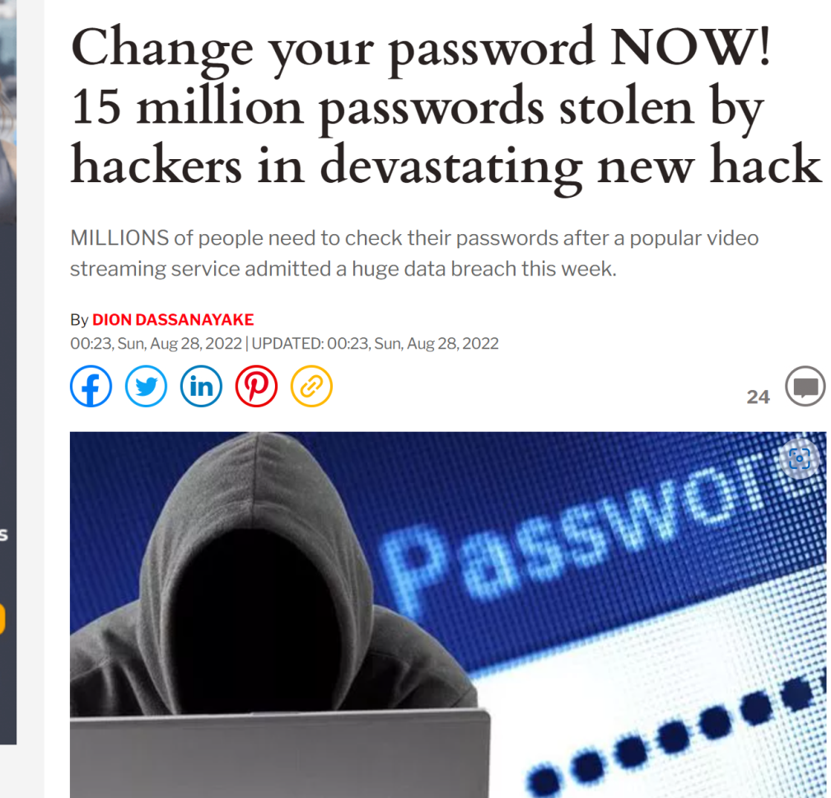
Risks of password leaking
1. Private information exposure
2. Money loss
3. Risks of ID frauds
Retrived from: Change your password NOW! 15 million Plex passwords stolen by hackers | Express.co.uk

Slide 9
Technologies Used
Web-based software
Tools: Apache, Nodejs
Modules: express, ejs, cookie-parser
Languages: Javascript, Javascript( embedded ), HTML, CSS
Request method: POST / GET

Slide 10
methodology
4 reasons for using waterfall methodology
The requirements are clear.
Relatively simple system.
Only used in certain circumstances
Unlikely to be changed.
1. Allow input of various input parameters on password such as Password Length, Include Special Characters, Numbers, Lower/Upper case Characters
2. Save the settings for future use
3. Generate a random password based on the above parameters
4. Copy function to copy the generated password to the buffer (like Control + C)
Retrived from: project list

Slide 11
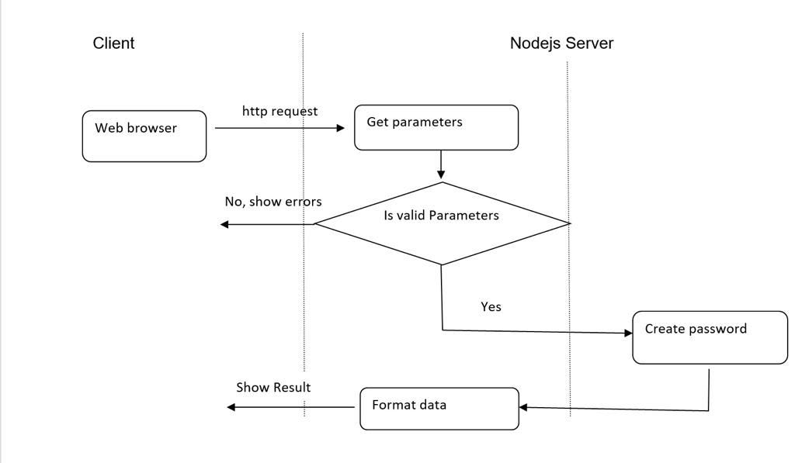
TEAM WORK

Slide 12
TEAM WORK
Client (Richard)
User Interface (HTML/ejs, CSS, embedded javascript)
Server (Steven)
request process (javascript)
. Cookies process (javascript)
Server( Maribeth)
implement a module for Password Generator (javascript)

Slide 13
Reflections
Maribeth: mamamam
Richard:
Steven:

Slide 14
References

Slide 15
Q&A
Answer Questions

